Slide 1

Exploratory Data Analysis
G2M insight for Cab Investment firm
19/09/2024

Slide 2
Agenda
Executive Summary
Problem Statement
Approach
EDA
EDA Summary
Recommendations

Slide 3
Executive Summary
XYZ, a private US-based firm, is considering investment opportunities in the rapidly growing cab industry. To inform their decision, they are seeking actionable insights based on historical data from two cab companies over a three-year period (2016-2018). The objective is to analyze customer behavior, company performance, and market trends to determine which company offers the most promising investment opportunity. The analysis will involve various hypotheses, detailed data exploration, and integration of external data sources (e.g., weather and holiday data) to identify key patterns and make strategic recommendations.

Slide 4
Problem Statement
XYZ is looking to invest in the US cab industry, which has seen significant growth and competition in recent years. To guide their investment decision, they require a thorough analysis of two cab companies, focusing on customer demographics, transaction patterns, market trends, and company performance.
The challenge is to identify the company with the highest potential for growth and profitability by understanding customer behavior, detecting trends, and uncovering key insights that will inform XYZ’s Go-to-Market (G2M) strategy.

Slide 5
Approach
We collected four data sets namely: Cab_Data.csv, Customer_ID.csv, Transaction_ID.csv and City.csv.
We performed an EDA to understand the relations between the data and to determine which company is a better choice for investment opportunity for XYZ.
We generated the following hypothesis to further investigate:
●Which cab is more popular in different cities?
● Which cab will people with different income choose?
●What is the cost trip of each cab?

Slide 6
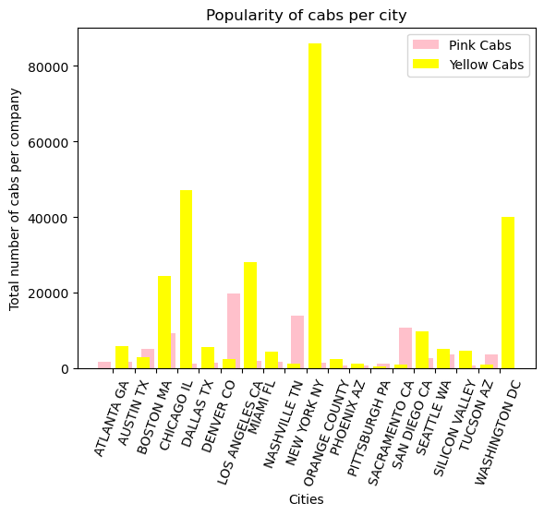
Exploratory Data Analysis
Yellow cars are more popular in different Cities than Pink cars.

Slide 7
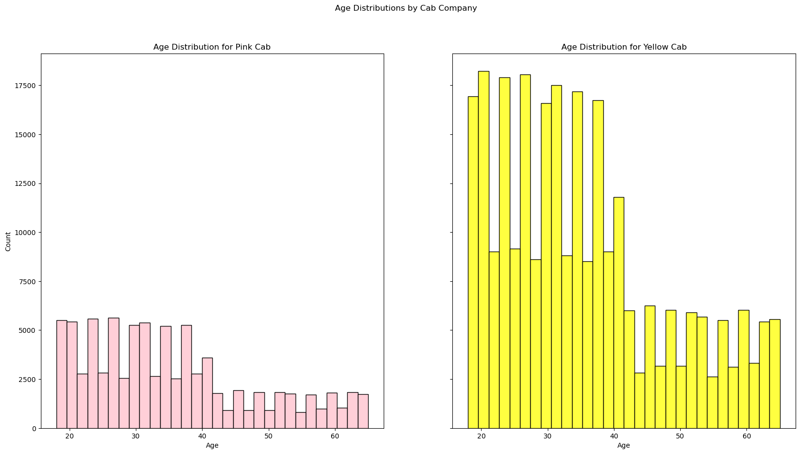
EDA
People of all age use more yellow cab than pink cab.

Slide 8
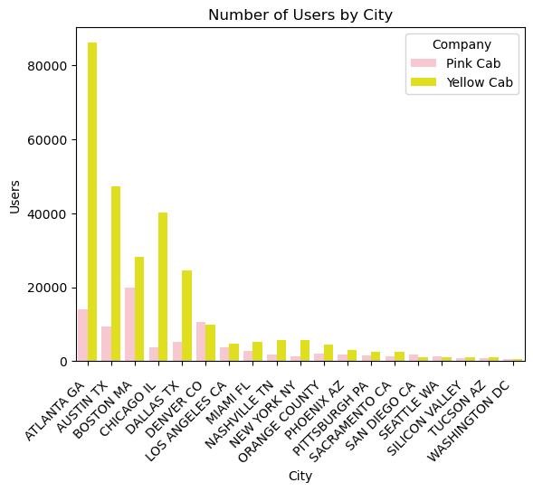
EDA
Majority of the cab users take yellow can more than pink can in each city.

Slide 9
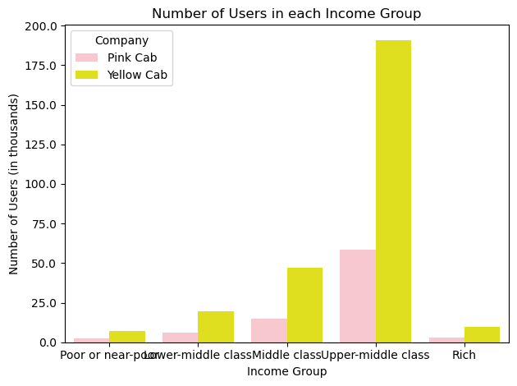
EDA
Every income group people prefer to use more yellow can than pink cab.

Slide 10
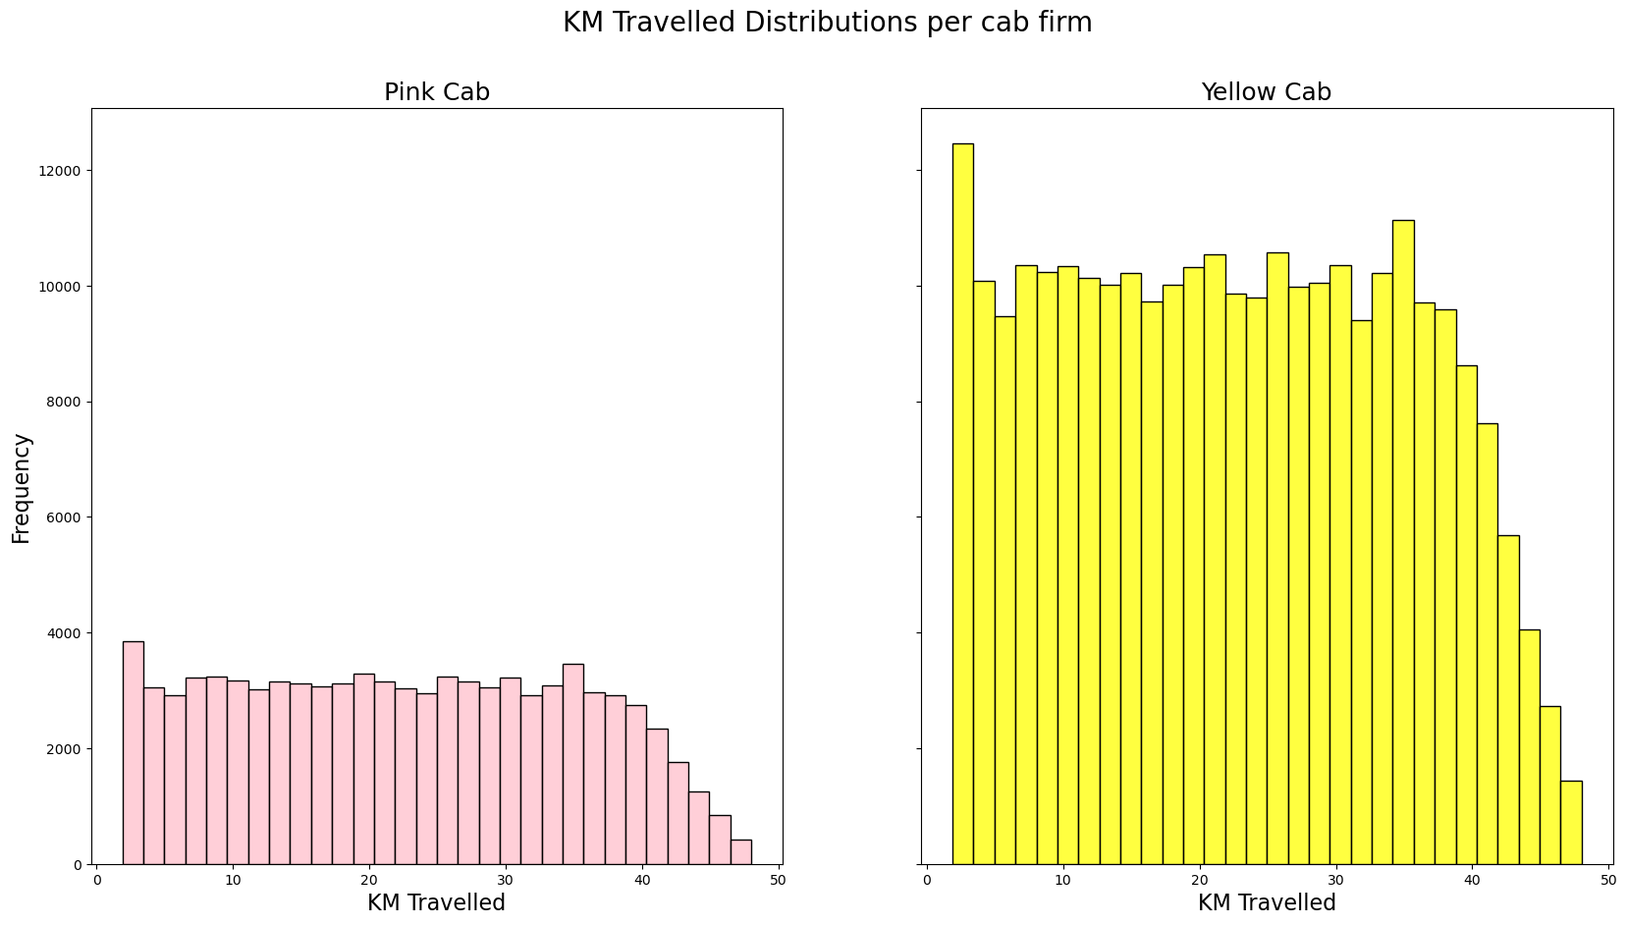
Distance travelled by yellow cab is more than pink cab.

Slide 11
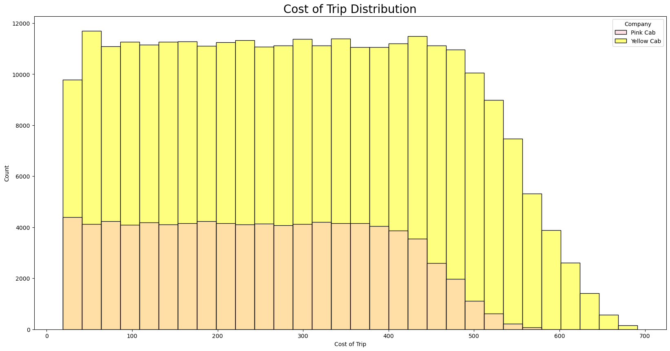
EDA

Slide 12
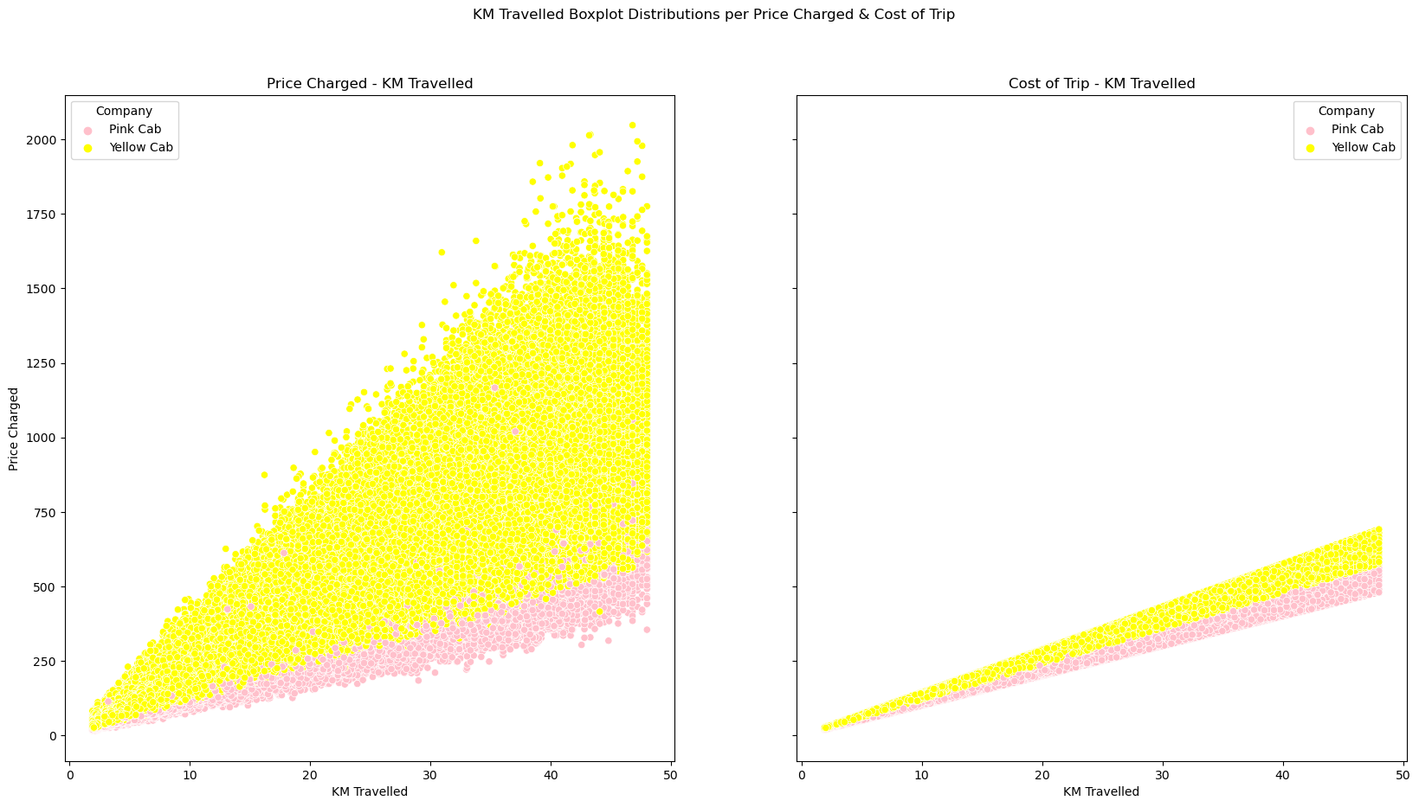

Slide 13
EDA Summary and Recommendation
Following the analysis, we can state that the yellow company is the one in which the investment should be made, and as a result, it is the one that will make the most money and attract the most customers. The reasons for this are as follows:
Yellow cab is more popular in cities than pink cab.
People of all age use more yellow cab than pink cab.
Majority of the cab users take yellow can more than pink can in each city.
Every income group people prefer to use more yellow can than pink cab.
Distance travelled by yellow cab is more than pink cab.
Cost of trip for yellow cab is more than pink cab.
The profit generated by yellow cab is more than pink cab.
Thank You

